Slide 1

Chapter 10 Part 1
Transaction Management and
Concurrency Control
The slides in this presentation have been adapted from slides provided with the textbook, Database Systems: Design, Implementation, and Management,
12E, Cornel and Morris, Copyright © 2017 Cengage Learning.

Slide 2
Learning Objectives
About database transactions and their properties
How database recovery management is used to maintain database integrity
Copyright © 2017 Cengage Learning
2

Slide 3
Transaction
Logical unit of work that must be entirely completed or aborted
Consists of:
SELECT statement
Series of related UPDATE statements
Series of INSERT statements
Combination of SELECT, UPDATE, and INSERT statements
Copyright © 2017 Cengage Learning
3

Slide 4
Transaction
Consistent database state: All data integrity constraints are satisfied
Must begin with the database in a known consistent state to ensure consistency
Formed by two or more database requests
Database requests: Equivalent of a single SQL statement in an application program or transaction
Consists of a single SQL statement or a collection of related SQL statements
Copyright © 2017 Cengage Learning
4

Slide 5
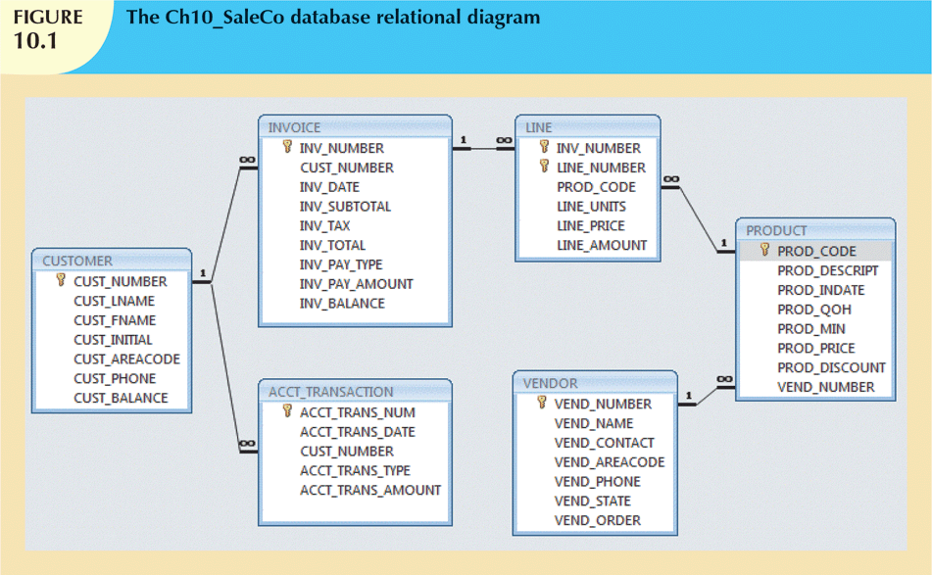
Copyright © 2017 Cengage Learning
5

Slide 6
Evaluating Transaction Results
Not all transactions update database
SQL code represents a transaction because database was accessed
Improper or incomplete transactions can have devastating effect on database integrity
Some DBMSs provide means by which user can define enforceable constraints
Other integrity rules are enforced automatically by the DBMS
Copyright © 2017 Cengage Learning
6

Slide 7
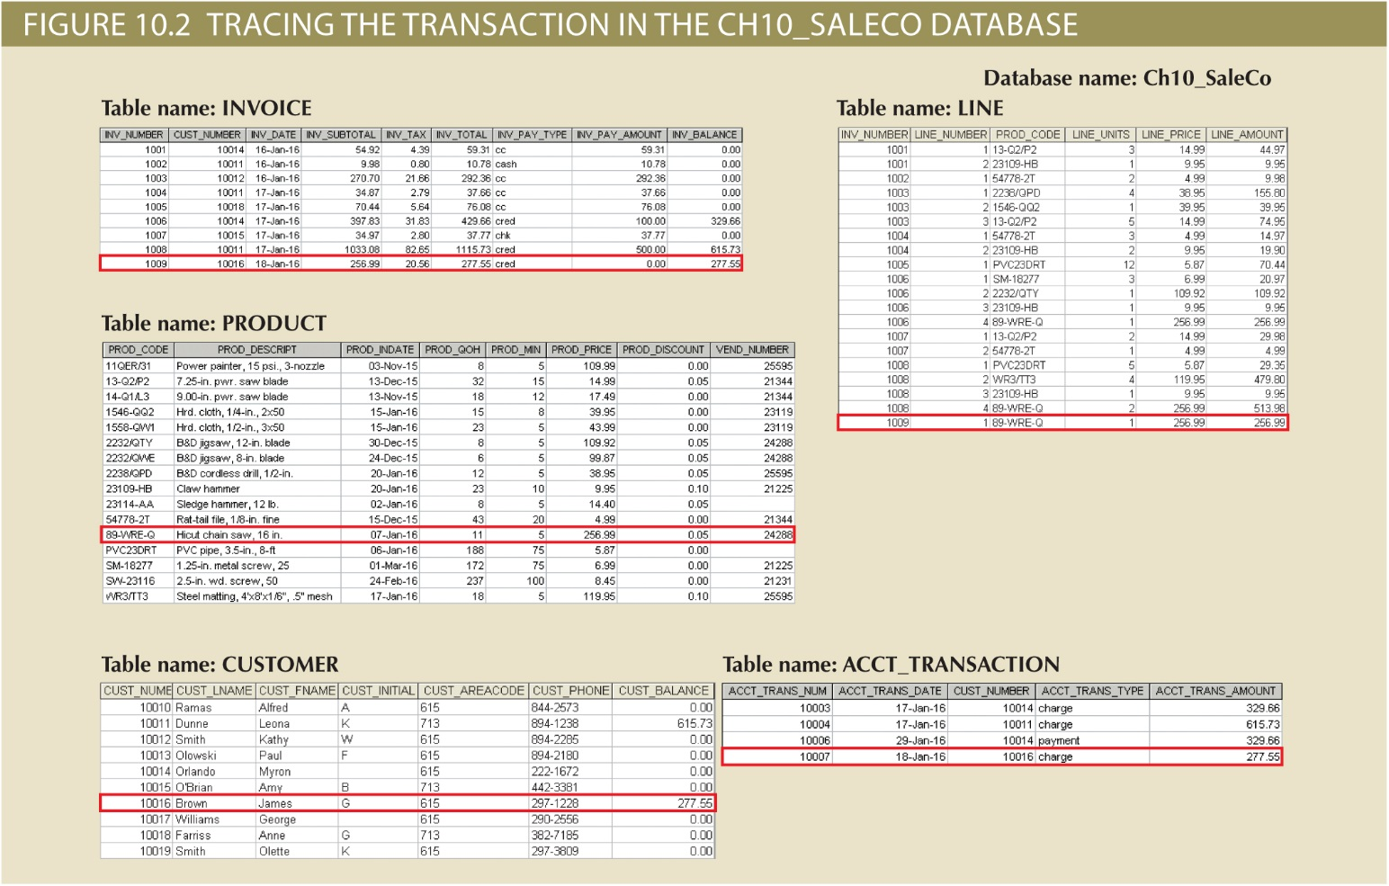
Copyright © 2017 Cengage Learning
7

Slide 8
Transaction Properties
Atomicity
All operations of a transaction must be completed
Consistency
Permanence of database’s consistent state
Isolation
Data used during transaction cannot be used by second transaction until the first is completed
Copyright © 2017 Cengage Learning
8

Slide 9
Transaction Properties (cont’d.)
Durability
Once transactions are committed, they cannot be undone
Serializability
Concurrent execution of several transactions yields consistent results
Multiuser databases are subject to multiple concurrent transactions
Copyright © 2017 Cengage Learning
9

Slide 10
Transaction Management with SQL
SQL statements that provide transaction support
COMMIT
ROLLBACK
Transaction sequence must continue until:
COMMIT statement is reached
ROLLBACK statement is reached
End of program is reached
Program is abnormally terminated
Copyright © 2017 Cengage Learning
10

Slide 11
Transaction Log
Keeps track of all transactions that update the database
DBMS uses the information stored in a log for:
Recovery requirement triggered by a ROLLBACK statement
A program’s abnormal termination
A system failure
Copyright © 2017 Cengage Learning
11

Slide 12
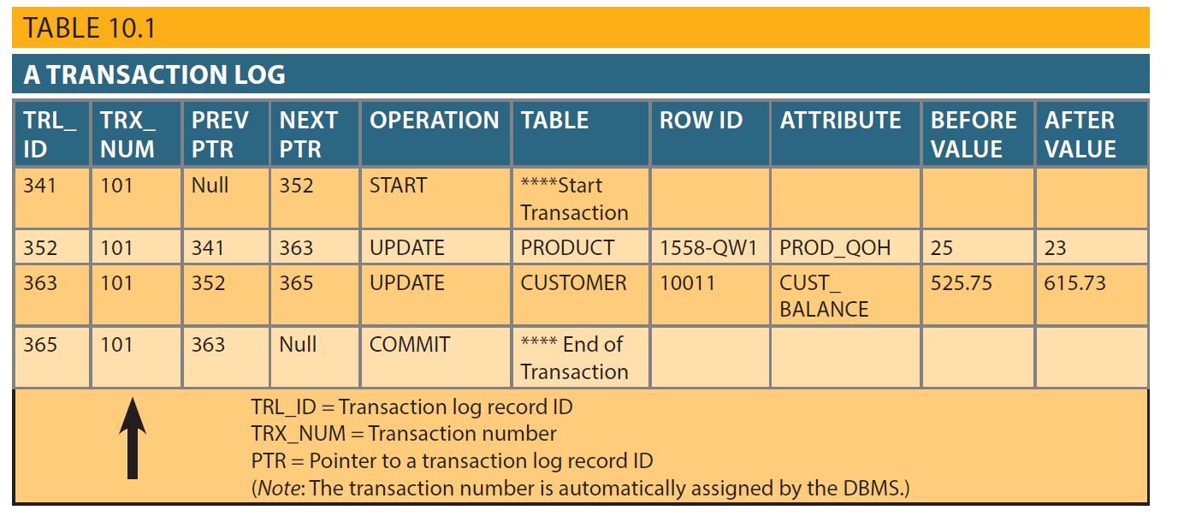
Transaction Log
Copyright © 2017 Cengage Learning
12

Slide 13
Database Recovery Management
Database recovery: Restores database from a given state to a previously consistent state
Recovery transactions are based on the atomic transaction property
Atomic transaction property: All portions of a transaction must be treated as a single logical unit of work
If transaction operation cannot be completed:
Transaction must be aborted
Changes to database must be rolled back
Copyright © 2017 Cengage Learning
13

Slide 14
Concepts that Affect Transaction Recovery
Write-ahead log protocol
Redundant transaction logs
Buffers
Ensures that transaction logs are always written before the data are updated
Ensure that a physical disk failure will not impair the DBMS’s ability to recover data
Temporary storage areas in a primary memory
Checkpoints
Allows DBMS to write all its updated buffers in memory to disk
Copyright © 2017 Cengage Learning
14

Slide 15
Transaction Recovery (cont’d.)
Deferred-write technique
Only transaction log is updated
Recovery process: identify last checkpoint
If transaction committed before checkpoint
Do nothing
If transaction committed after checkpoint
Use transaction log to redo the transaction
If transaction had ROLLBACK operation
Do nothing
Copyright © 2017 Cengage Learning
15

Slide 16
Transaction Recovery (cont’d.)
Write-through technique
Database is immediately updated by transaction operations during transaction’s execution
Recovery process: identify last checkpoint
If transaction committed before checkpoint
Do nothing
If transaction committed after last checkpoint
DBMS redoes the transaction using “after” values
If transaction had ROLLBACK or was left active
Do nothing because no updates were made
Copyright © 2017 Cengage Learning
16

Slide 17
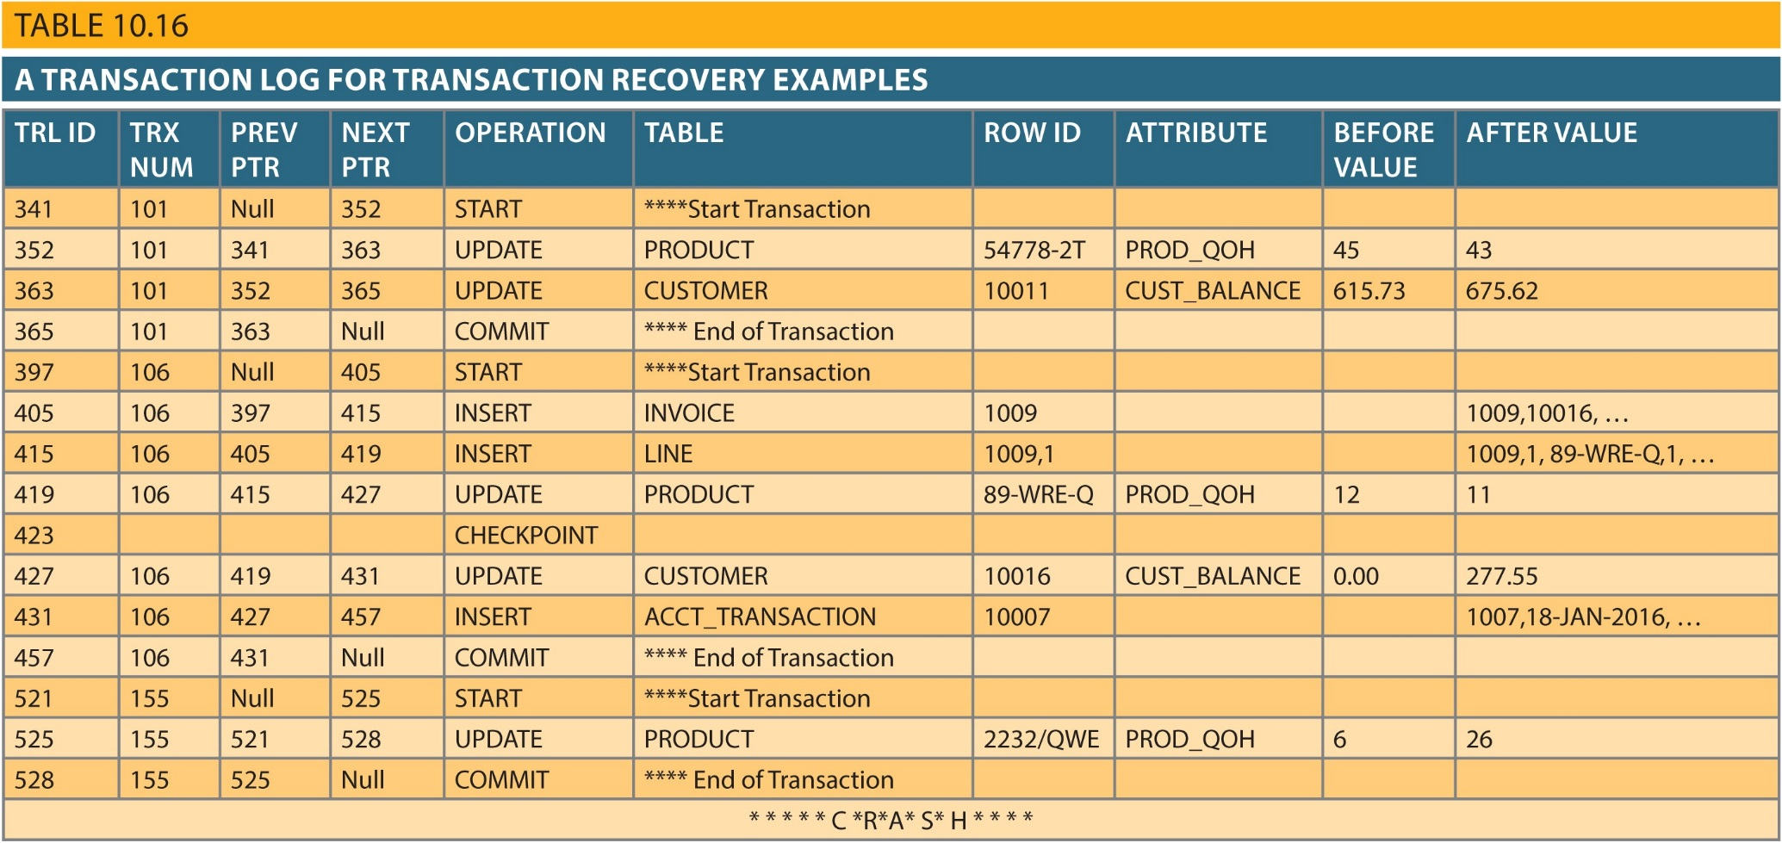
Copyright © 2017 Cengage Learning
17

Slide 18
Summary
Transaction: sequence of database operations that access database
Logical unit of work
No portion of transaction can exist by itself
Five main properties: atomicity, consistency, isolation, durability, and serializability
COMMIT saves changes to disk
ROLLBACK restores previous database state
SQL transactions are formed by several SQL statements or database requests
Copyright © 2017 Cengage Learning
18

Slide 19
Summary (cont’d.)
Transaction log keeps track of all transactions that modify database
Database recovery restores database from given state to previous consistent state
Copyright © 2017 Cengage Learning
19

Slide 20
Task
Explain the purpose and use of the Transaction Log.
Copyright © 2017 Cengage Learning
20

